Slide 1
Integrating Open Data for GDP Prediction Leveraging ALITE and Machine Learning
Proposal On
Madhu Mausam Thapa u1463636@utah.edu
u1463636
Sanjay Luitel u1559592@utah.edu
u1559592
Sushil Rijal
u1323213@utah.edu
u1323213

Slide 2

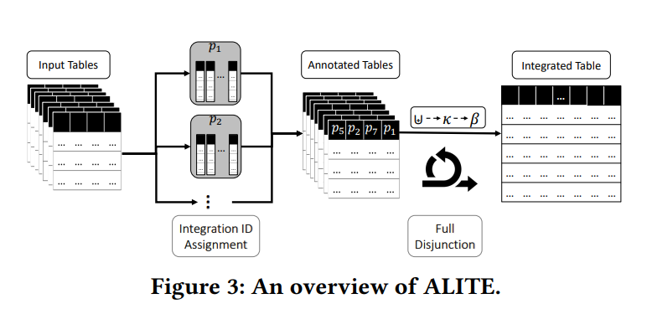
Introduction/ Motivation
Accurate GDP prediction is critical for decision-making but relies on high-quality, integrated data from diverse sources, such as investment, productivity, human capital, and demographic statistics.
Manual data integration is inefficient, error-prone, and often struggles with large datasets.
Automated tools like ALITE promise to improve data completeness and scalability for GDP forecasting.
Therefore, this study evaluates ALITE’s performance in data completeness and scalability for GDP-related data preparation and forecasting.
Source:- Khatiwada et al.- 2022

Slide 3
Why is it interesting????
Bridges data management and Machine Learning
Demonstrates the power of integrating heterogeneous datasets for ML applications.
Uses ALITE for automated data integration, reducing preprocessing overhead.
Real-World Insight/ Impact
Understanding the relationship between the Factor of production and GDP, as well as enhancing prediction accuracy, benefits economic planning and decision-making

Slide 4
Datasets
Capital Stock Data
Schema
IMFInvestmentandCapitalStockDataset2021 (isocode TEXT NOT NULL, ifscode INTEGER NOT NULL, country TEXT NOT NULL, year INTEGER NOT NULL, igov_rppp INTEGER, kgov_rppp INTEGER, ipriv_rppp INTEGER, kpriv_rppp INTEGER, ippp_rppp INTEGER, kppp_rppp INTEGER, GDP_rppp FLOAT, igov_n INTEGER, kgov_n INTEGER, ipriv_n INTEGER, kpriv_n INTEGER, kppp_n INTEGER, GDP_n FLOAT, income TEXT, PRIMARY KEY (country, year))
11640 records
194 Countries
From 1960 to 2019

Slide 5
Datasets (Continue….. )
2. Human Capital Data
Schema
Human_Captial(series_name TEXT, series_code TEXT, country_name TEXT, country_code TEXT, yr1960 FLOAT, yr1961 FLOAT, ………………………………………., yr2023 FLOAT, PRIMARY KEY (country_code, series_code));
Categories in series name
Human capital index (HCI) (scale 0-1)
Labor force, total
Unemployment, total (% of total labor force) (modeled ILO estimate)
798 records

Slide 6
Datasets (Continue….. )
3. Productivity and Research Data
Schema
Productivity_Research(series_name TEXT, series_code TEXT, country_name TEXT, country_code TEXT, yr1960 FLOAT, yr1961 FLOAT, yr1962 FLOAT, …………………………, yr2023 FLOAT);
Categories in series name
Energy use (kg of oil equivalent per capita)
Energy use (kg of oil equivalent) per $1,000 GDP (constant 2021 PPP)
GDP per unit of energy use (constant 2021 PPP $ per kg of oil equivalent)
GDP per unit of energy use (PPP $ per kg of oil equivalent)
Patent applications, nonresidents
Patent applications, residents
Research and development expenditure (% of GDP)
Researchers in R&D (per million people)
2128 records

Slide 7
Datasets (Continue….. )
4. Population Data
Schema
country_statistics (Country_Name VARCHAR(255), Country_Code VARCHAR(10), Series_Name VARCHAR(255), Series_Code VARCHAR(50), YR1960 DECIMAL, YR1961 DECIMAL, YR1962 DECIMAL, YR1963 DECIMAL, YR1964 DECIMAL,………………, YR2049 DECIMAL, YR2050 DECIMAL);
Categories in series name
Age dependency ratio (% of working-age population)
Age dependency ratio, old
…..
……
Urban population (% of total population)
Urban population growth (annual %)
6118 records
23 Categories

Slide 8
Methodology
TASK 1:- Combine Four Datasets for Further Processing
Selection of Relevant Columns in Each Dataset
Merge tables using ALITE and outer/inner join
Merge Schema
GDP_dataset (country TEXT NOT NULL, year INTEGER NOT NULL, G_stock FLOAT, p_stock FLOAT, working_population FLOAT, HCI FLOAT, Unemployment_rate FLOAT, Energy_use FLOAT, Researchers_in_RD FLOAT, GDP_rppp FLOAT, PRIMARY KEY (country, year));

Slide 9
Methodology (Continue……….)
TASK 2:- Data Preprocessing
Data Cleaning
Removing of Duplicates
Handle inconsistent and incorrect data (e.g., country name)
Standardize column name and data format
2. Handling Missing Values
Identify and replace null values with suitable alternatives (e.g., mean, mode, forward/backward fill, drop row)

Slide 10
Methodology (Continue……….)
TASK 3:- Machine Learning Model Development
Multiple Linear Regression
Log-Linear Regression
Log-Linear Regression with Country and Decade Parameter
Random Forest Regression
Feature engineering, cross-validation, hyperparameter tuning and deployment of APACHE Spark will be used
Furthermore, SHAP (SHapley Additive exPlanations) values will be evaluated to interpret and explain the contribution of each feature to the model's predictions.

Slide 11
Methodology (Continue……….)
TASK 4:- Evaluation
Root Mean Square Error (RMSE)
Mean Absolute Error (MAE)
Mean Square Percentage Error (MAPE)
Coefficient of Determination (R²)
ALLITE Vs Outer/Inner Join
Data completeness (measuring missing values and Pearson correlation in merge data)
Scalability (comparing integration time)

Slide 12
Timeline & Deliverables
TASK 4:- Evaluation
Week 1: Define scope & download datasets - Initial project plan
Week 2: Perform ALITE integration - Integrated dataset
Week 3 & 4: Preprocess data, create ML pipeline - Preprocessed dataset, Baseline model
Week 5 & 6: Train ML models, tune parameters - Trained models, results
Week 7: Analyze results, prepare report - Final results, Interpretability analysis
Week 8: Presentation & submission - Report, Code, Presentation slides

Slide 13

Thank You

